Slide 1
自我介紹
(niziima Live)
Notes:
大家好，接下來我會用故事七步驟跟大家說一個有關於我的故事

Slide 2
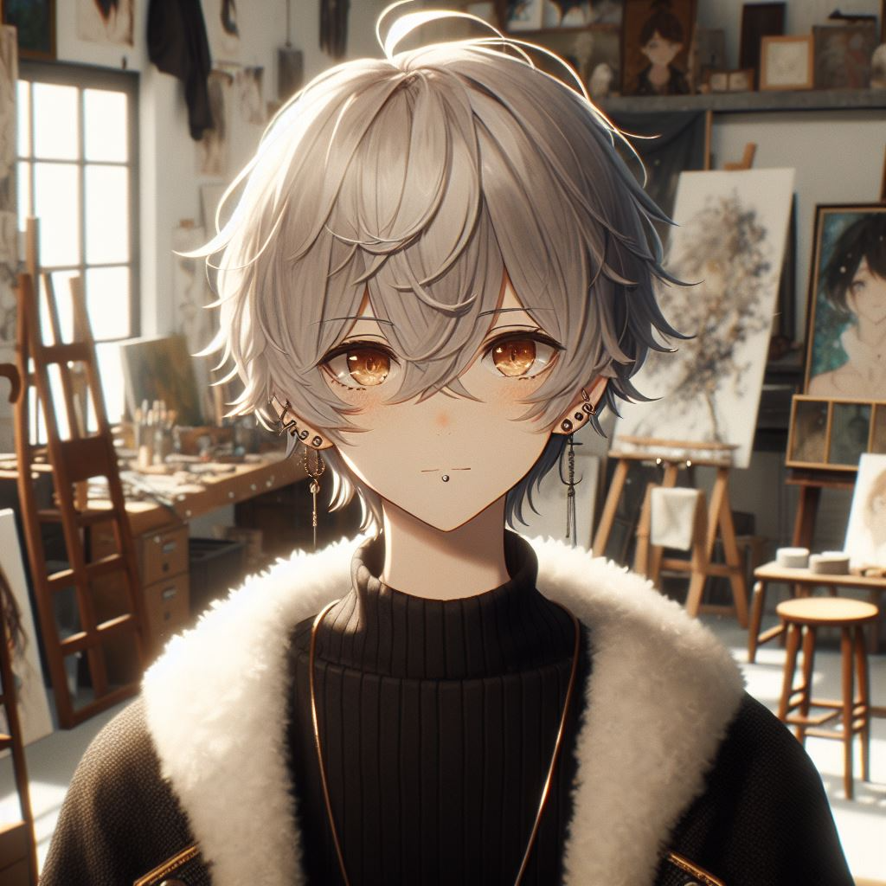
1. 目標
Notes:
an animated Japanese character with short silver-white hair, slightly messy but layered, with bangs slightly covering the forehead, golden-orange eyes with a soft and calm gaze, and gentle eye contours, wearing a black top with gold accents around the collar, and a coat with a white fur collar, standing in an art studio as a backdrop, surrounded by paintings and sculptures, with multiple earrings on both ears, visible piercings, and a noticeable mole below the left side of the lips, in Japanese Anime Style, with a slight smile, giving an overall serene and composed feeling
我是一名年輕的畫家夢想舉辦一場屬於自己的畫展

Slide 3

2. 阻礙
Notes:
A character with short silver-white hair, slightly messy but layered, with bangs slightly covering the forehead, golden-orange eyes with a soft and calm gaze, and gentle eye contours, wearing a black top with gold accents around the collar, and a coat with a white fur collar, standing in an art studio as a backdrop, surrounded by paintings and sculptures, with multiple earrings on both ears, visible piercings, and a noticeable mole below the left side of the lips, in Japanese Anime Style, sitting in a small and cluttered studio, reflecting an atmosphere of economic hardship, looking tired and focused, with a simple environment full of creative traces, in Japanese Anime Style
我投入所有精力創作，卻因為經濟困難無法負擔場地費用

Slide 4

3. 努力
Notes:
A character with short silver-white hair, slightly messy but layered, with bangs slightly covering the forehead, golden-orange eyes with a soft and calm gaze, and gentle eye contours, wearing a black top with gold accents around the collar, and a coat with a white fur collar, with multiple earrings on both ears, visible piercings, and a noticeable mole below the left side of the lips, in Japanese Anime Style, Working at a convenience store, with the backdrop at a convenience store, moving cardboard boxes, showing his hands
為了籌措資金，我決定白天兼職打工，晚上繼續畫畫

Slide 5

4. 結果
Notes:
A character wearing a black top with gold accents around the collar, and a coat that appears to have a white fur collar, is preparing for an art exhibition,he has short silver-white hair, slightly messy but layered, with bangs slightly covering the forehead, and golden-orange eyes, with a soft and calm gaze, and gentle eye contours. He is standing at an art exhibition, in Japanese anime style.
經過數月的辛勤工作，終於攢夠了錢，畫展的準備也逐漸就緒

Slide 6
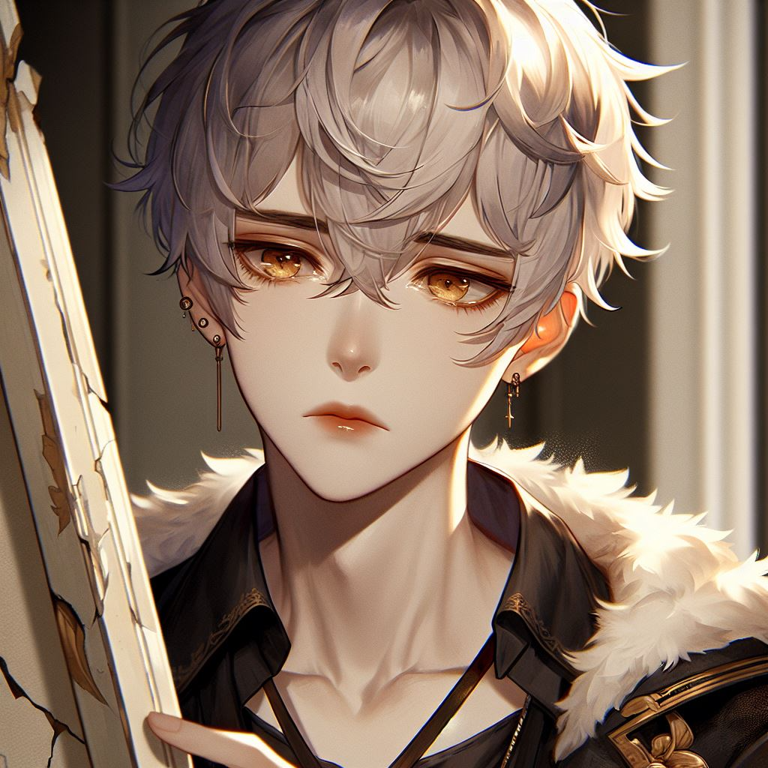
5. 意外
Notes:
A character looks sadly at a broken painting. He has short silver-white hair, slightly messy but layered, with bangs slightly covering the forehead, and golden-orange eyes, with a soft and calm gaze, and gentle eye contours. Wearing a black top with gold accents around the collar, and a coat that appears to have a white fur collar, with multiple earrings on both ears, with visible piercings. The painting is visibly broken.
就在畫展開幕前夕，我的一副畫作意外被弄壞了，這是我最喜愛的一件作品

Slide 7

6. 轉彎
Notes:
A character is painting. He has short silver-white hair, slightly messy but layered, with bangs slightly covering the forehead, and golden-orange eyes, with a soft and calm gaze, and gentle eye contours. Wearing a black top with gold accents around the collar, and a coat that appears to have a white fur collar, with multiple earrings on both ears, with visible piercings.
我心情低落，甚至一度考慮取消畫展，但經過深思熟慮，我決定將這次意外當作一種契機，轉而重新創作一幅全新的畫作

Slide 8

7. 結局
Notes:
A character wearing a black top with gold accents around the collar, and a coat that appears to have a white fur collar, is preparing for an art exhibition. He has short silver-white hair, slightly messy but layered, with bangs slightly covering the forehead, and golden-orange eyes, with a soft and calm gaze, and gentle eye contours. He is standing at an art exhibition, in Japanese anime style, with multiple earrings on both ears, with visible piercings. There is someone who wants to sign a contract with him. The person who wants to sign the contract with him and the contract can be noticed.
新作出乎意料地獲得了極大的迴響，畫展也因此大受歡迎，甚至吸引了知名畫廊的合作邀約。最終，我的藝術生涯由此展開

